Slide 1

Web Scraping on Job Market
FALL19’ Data Analytics Final Project

Slide 2
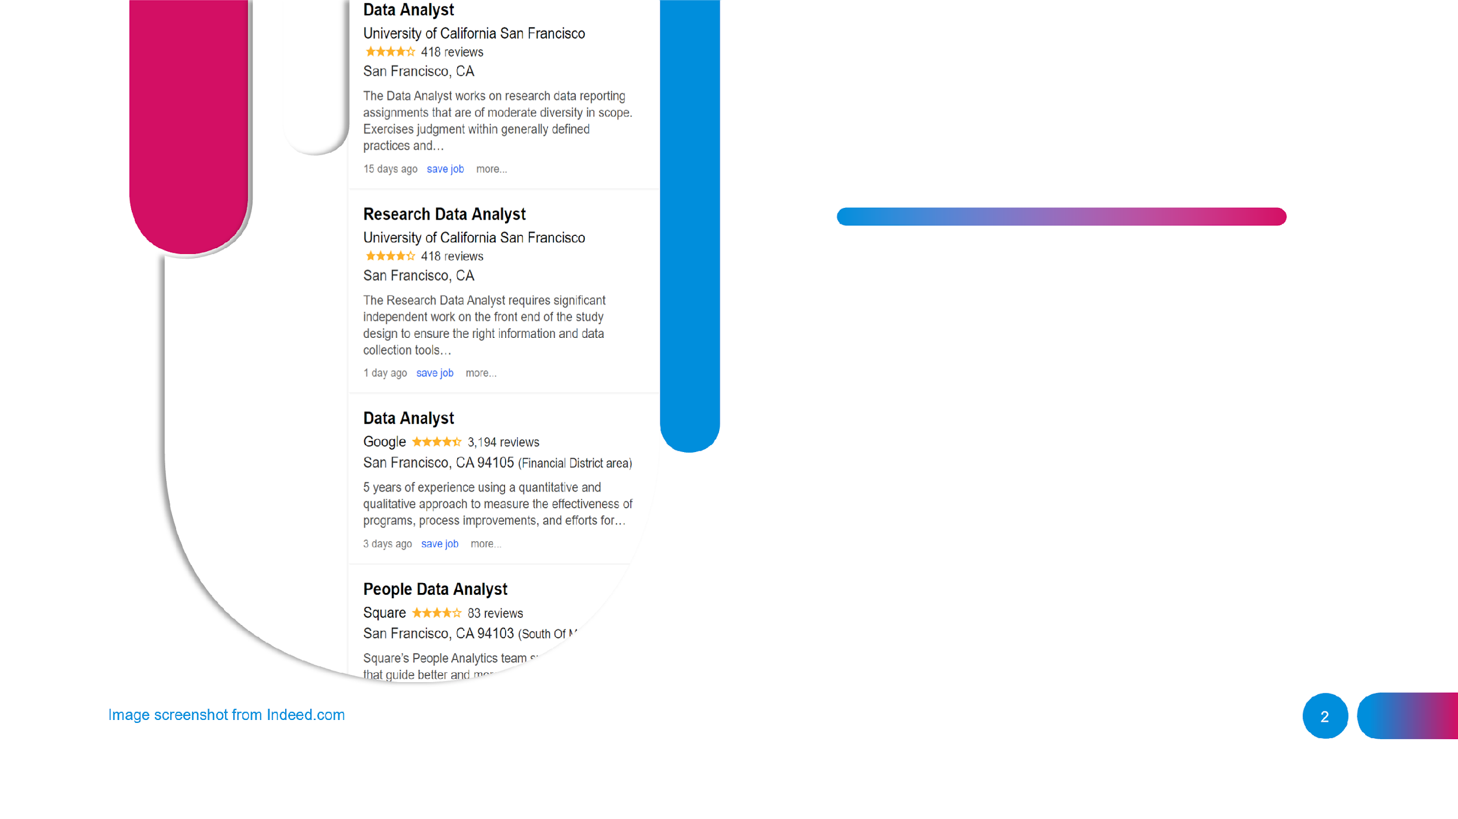

Data Sources
All job data was scraped from Indeed.com

Slide 3
SiteMap and Web Scraper from “Indeed”
Data Scraping
Data Filtering
Data Transformation
Parse Data
Data Cleaning
Visualization using pandas, matplotlib and Seaborn
Data Visualization
Interpretation and Comparison
Analysis

Slide 4
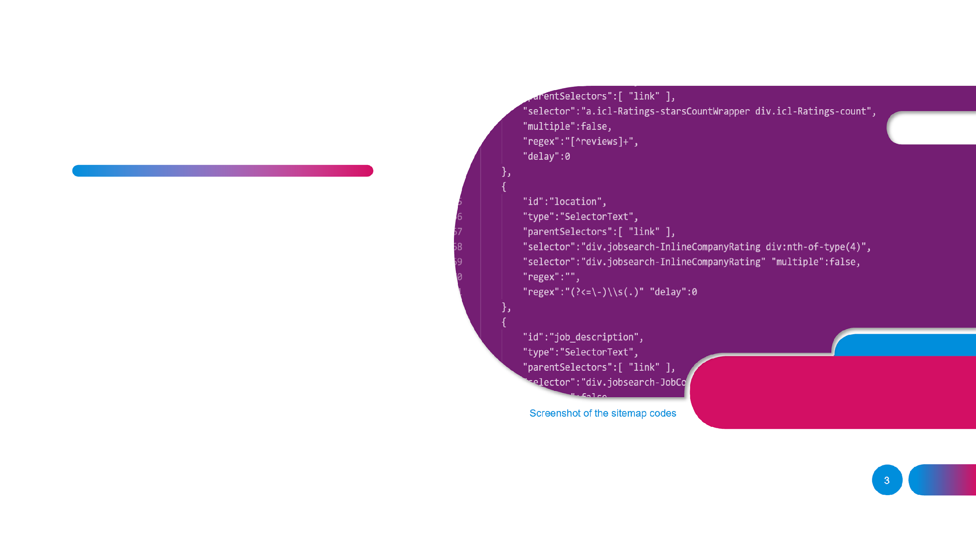
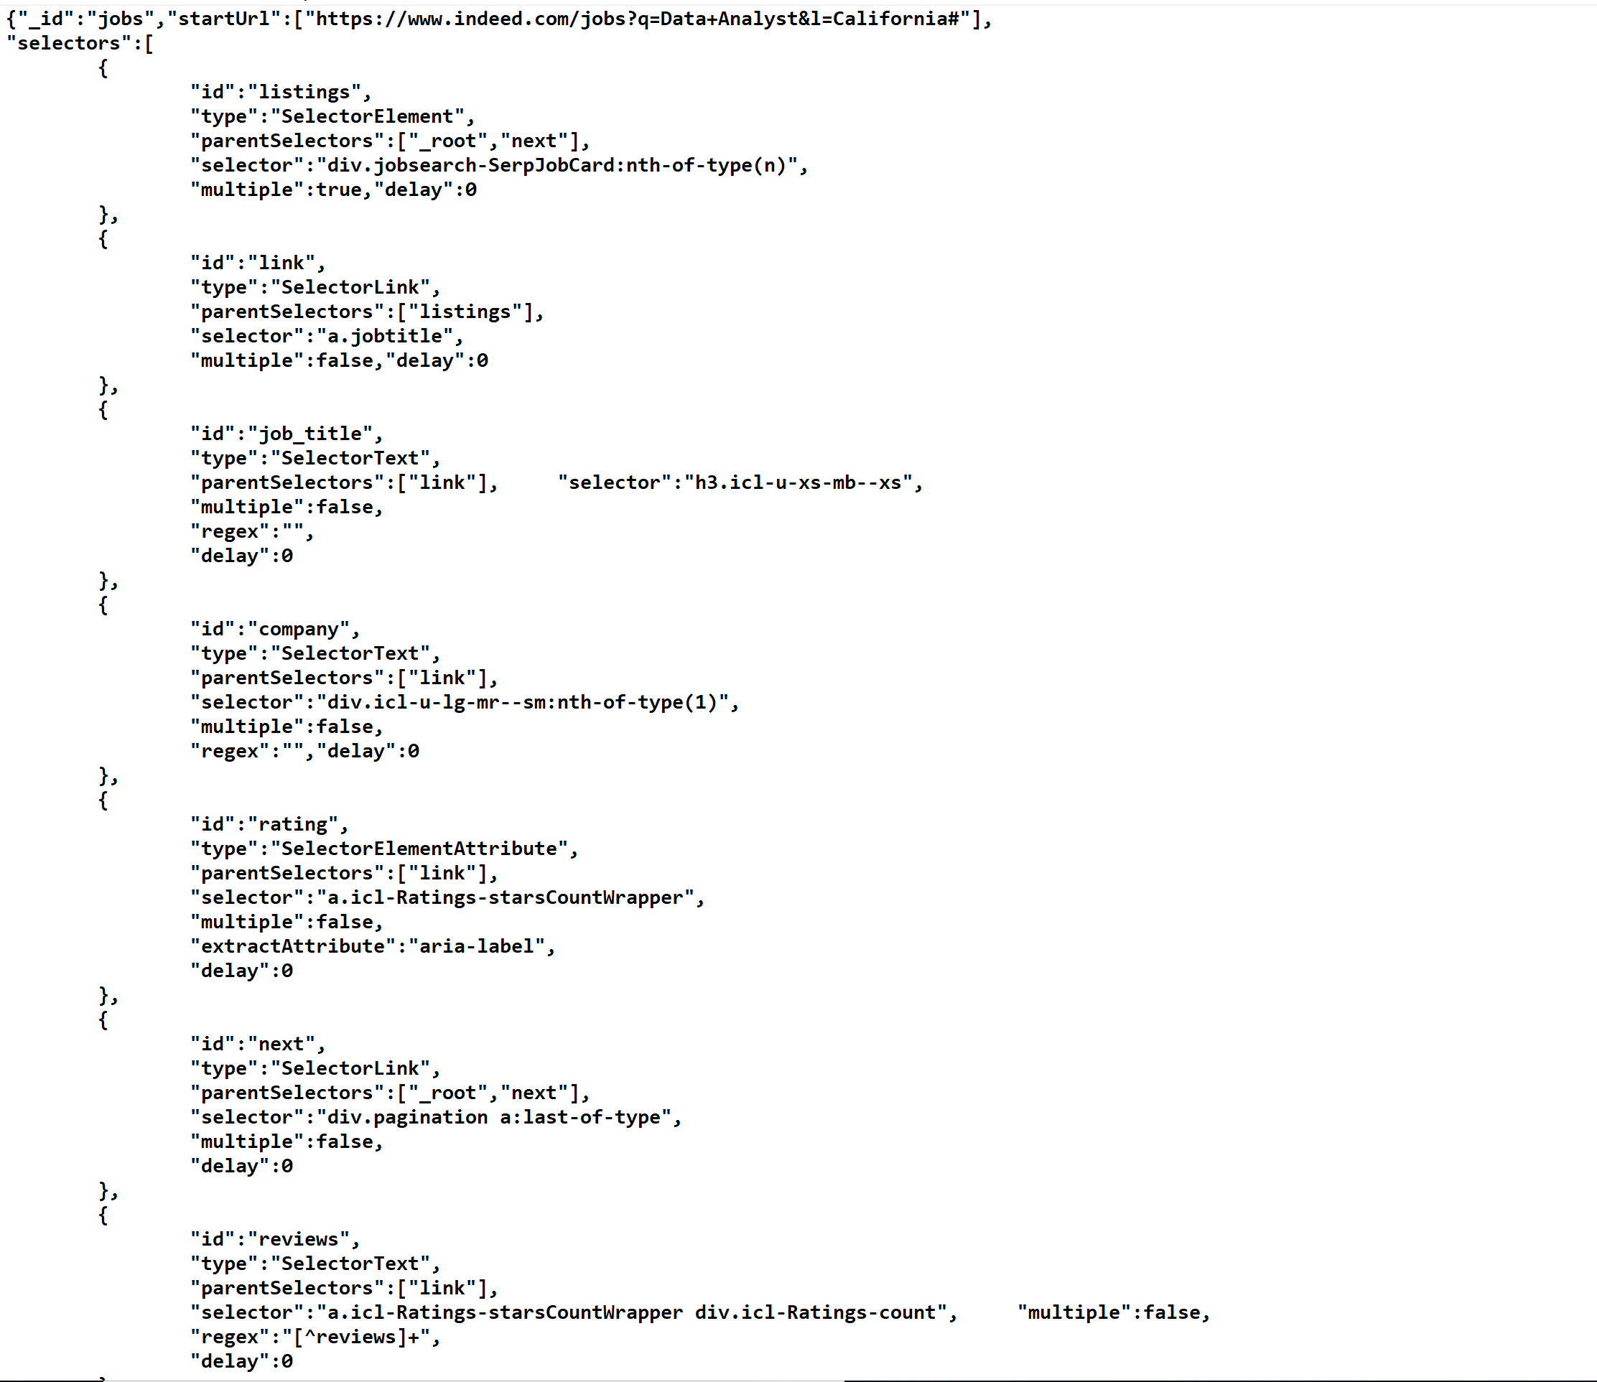
Data Scraping
Tools and Techniques used:
SiteMap JSON
– Layout of the web-content on the page.
Web Scraper
– Google Chrome Development Tools extension.

Slide 5
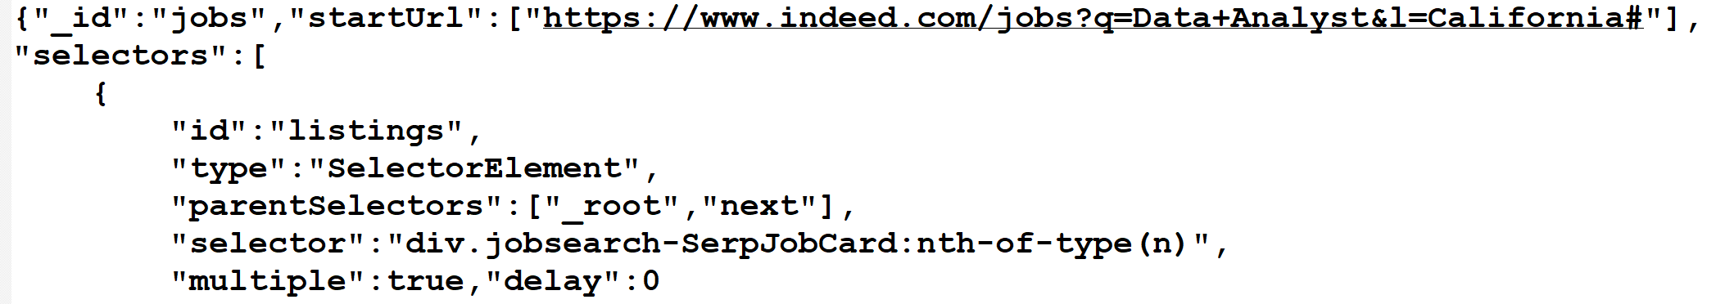
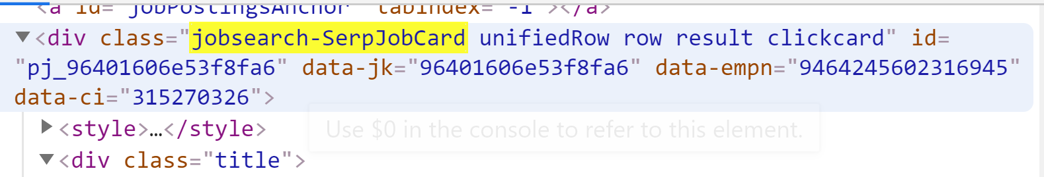
Matches selector with the nth element of the page.
Multiple selections True/False

Slide 6
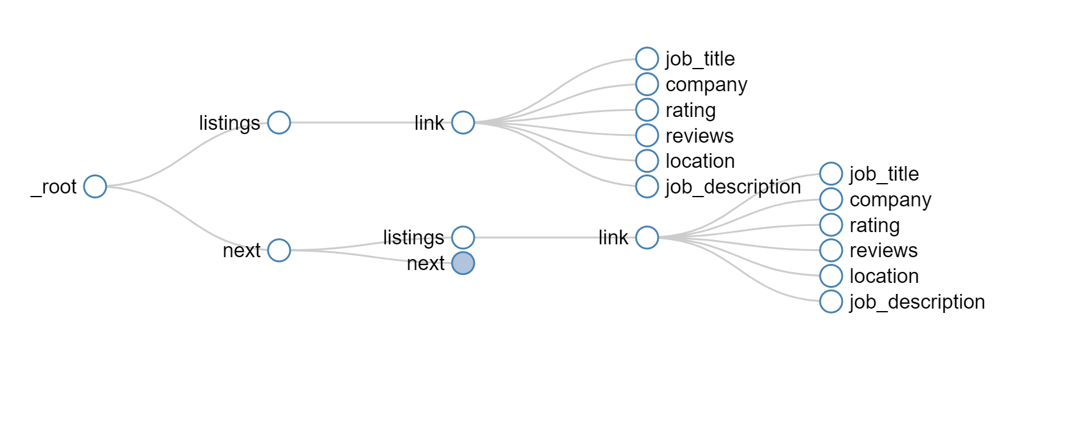
Scraping Flow
Search Result : Page 1
Search Result : Page 2
Root Selector

Slide 7
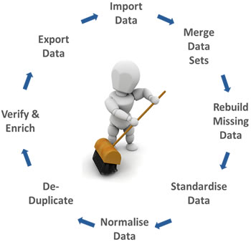
Data Cleaning
Procedures:
Treating blank cells (Fill blank cells with “0” or “NA”
Extra Spaces (Trim Function)
Remove Duplicates
Parsing Data using Text to Column
Sorting Data
Delete formatting

Slide 8
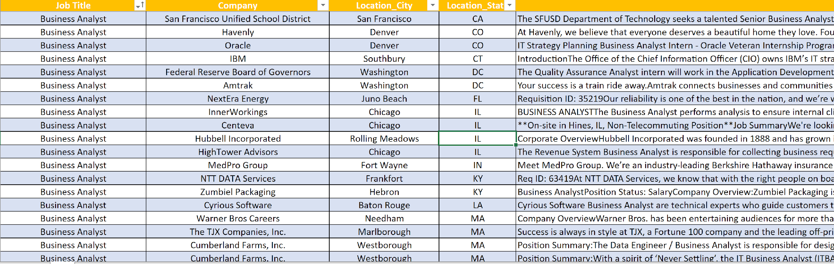
Data Set

Slide 9

Title-wise Analysis

Slide 10
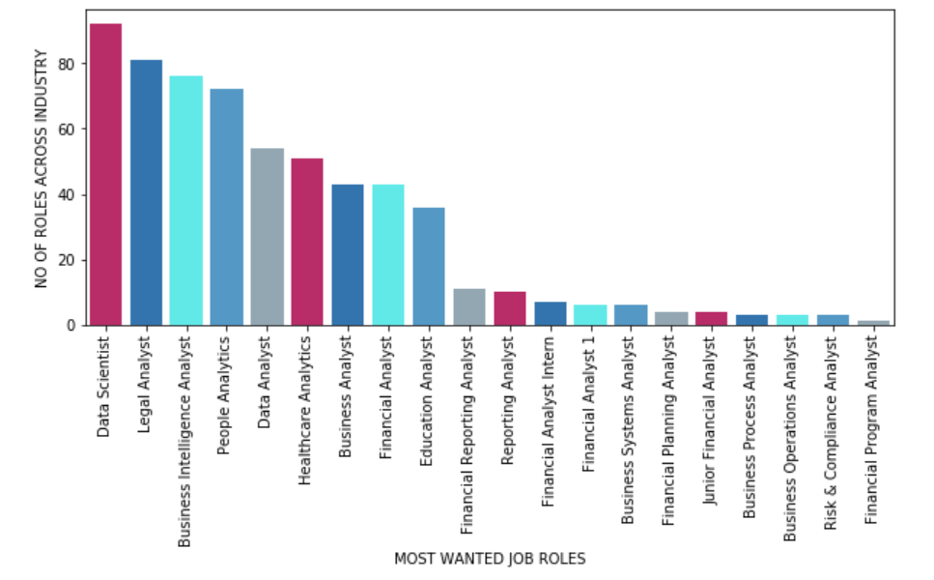
Job Roles across Industry

Slide 11
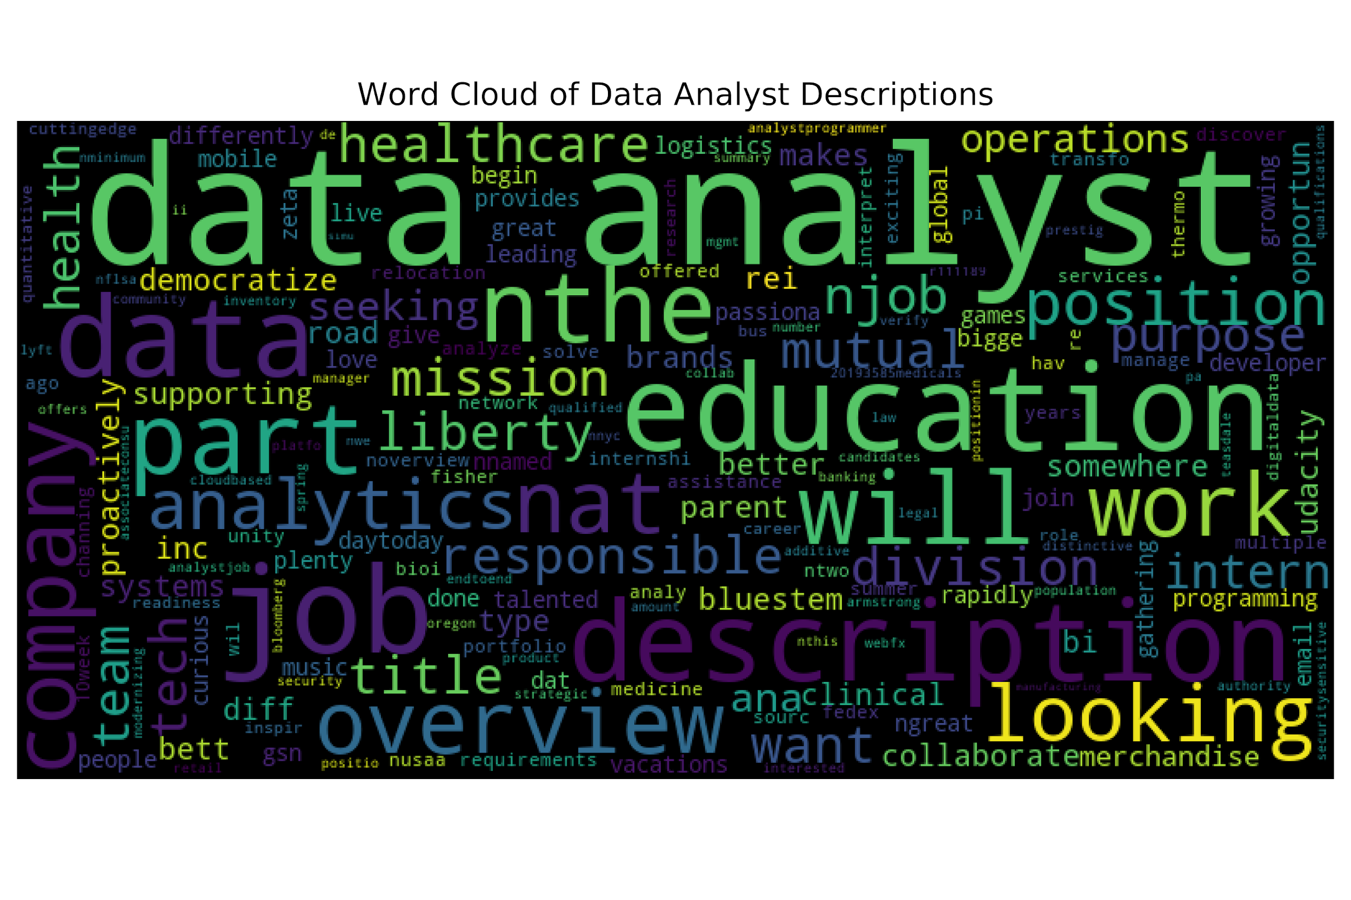
Word Cloud – Data Analyst

Slide 12
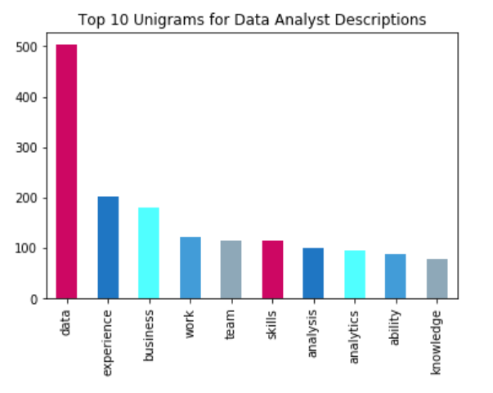
Word Ingram – Data Analyst

Slide 13
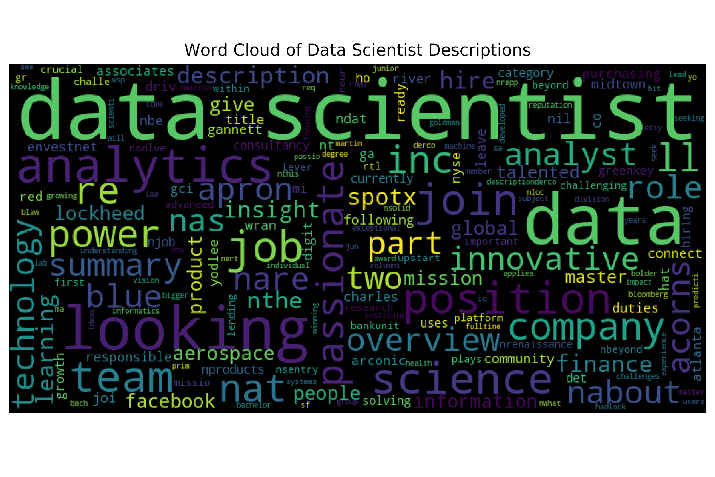
Word Cloud – Data Scientist

Slide 14
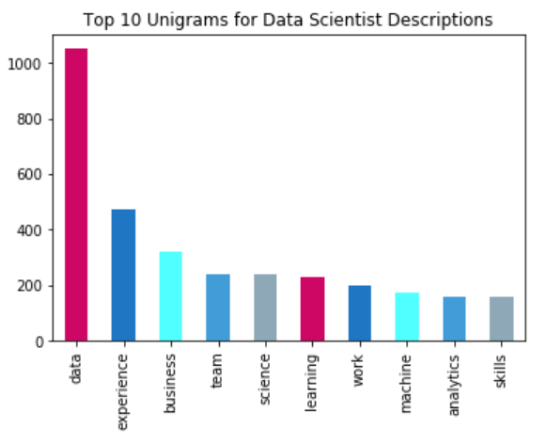
Word Ingram – Data Scientist

Slide 15

Location-wise Analysis

Slide 16
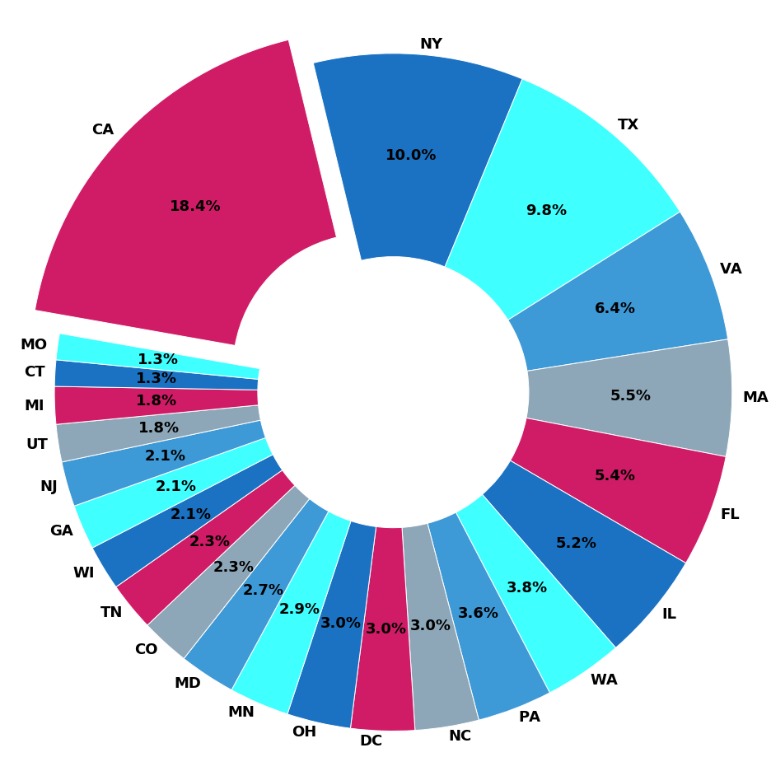
State Share
California has the largest share among the all the states, taking over 18.4% of the analyst job market.

Slide 17
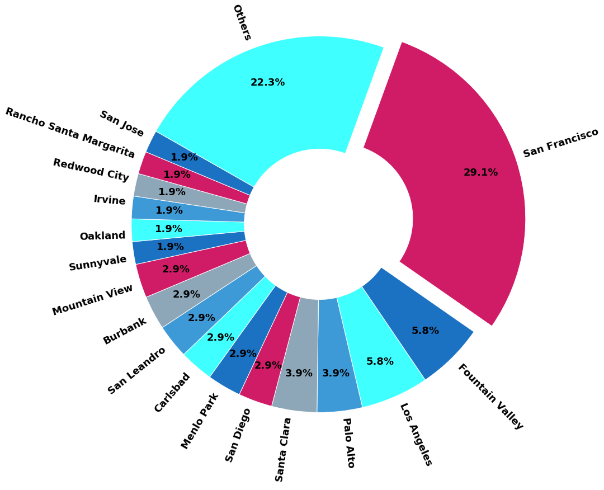
City Share in California
San Francisco takes over 29.1% of the analyst jobs in California job market, becoming the largest share among all the cities in California

Slide 18
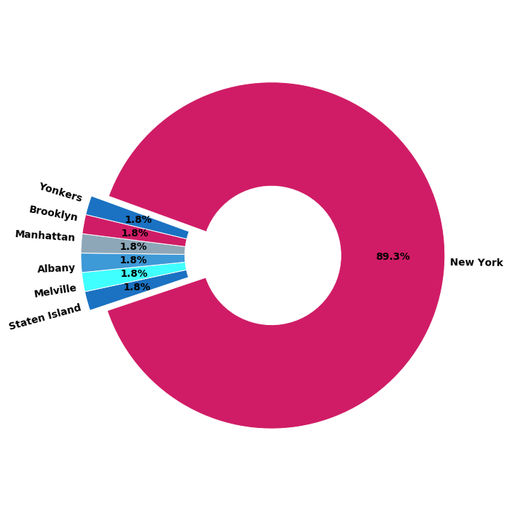
City Share in New York
New York City takes over the majority, almost being 90%, analyst roles in New York job market, and other cities in New York share the rest of the analyst jobs equally.

Slide 19
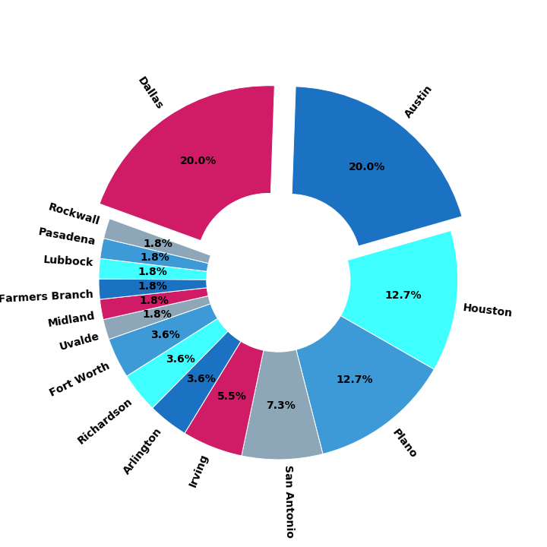
City Share in Texas
Each of Dallas and Austin takes over 20% of the analyst jobs in Texas job market, and each of Houston and Plano take over 12.7% of the analyst roles in Texas job market. These four cities take over most of the analyst jobs in Texas.

Slide 20
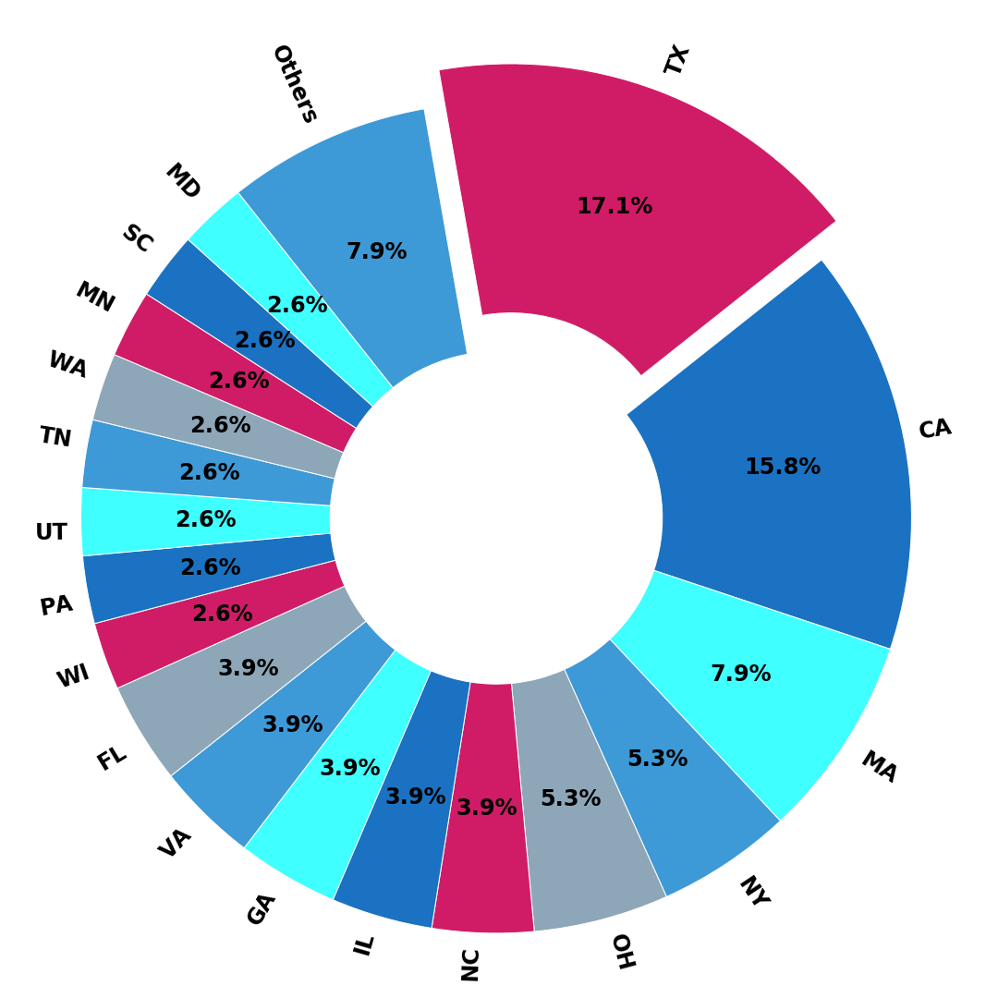
Which State Needs Financial Analysts The Most?
Texas needs Financial analyst the most, secondly it’s California.

Slide 21
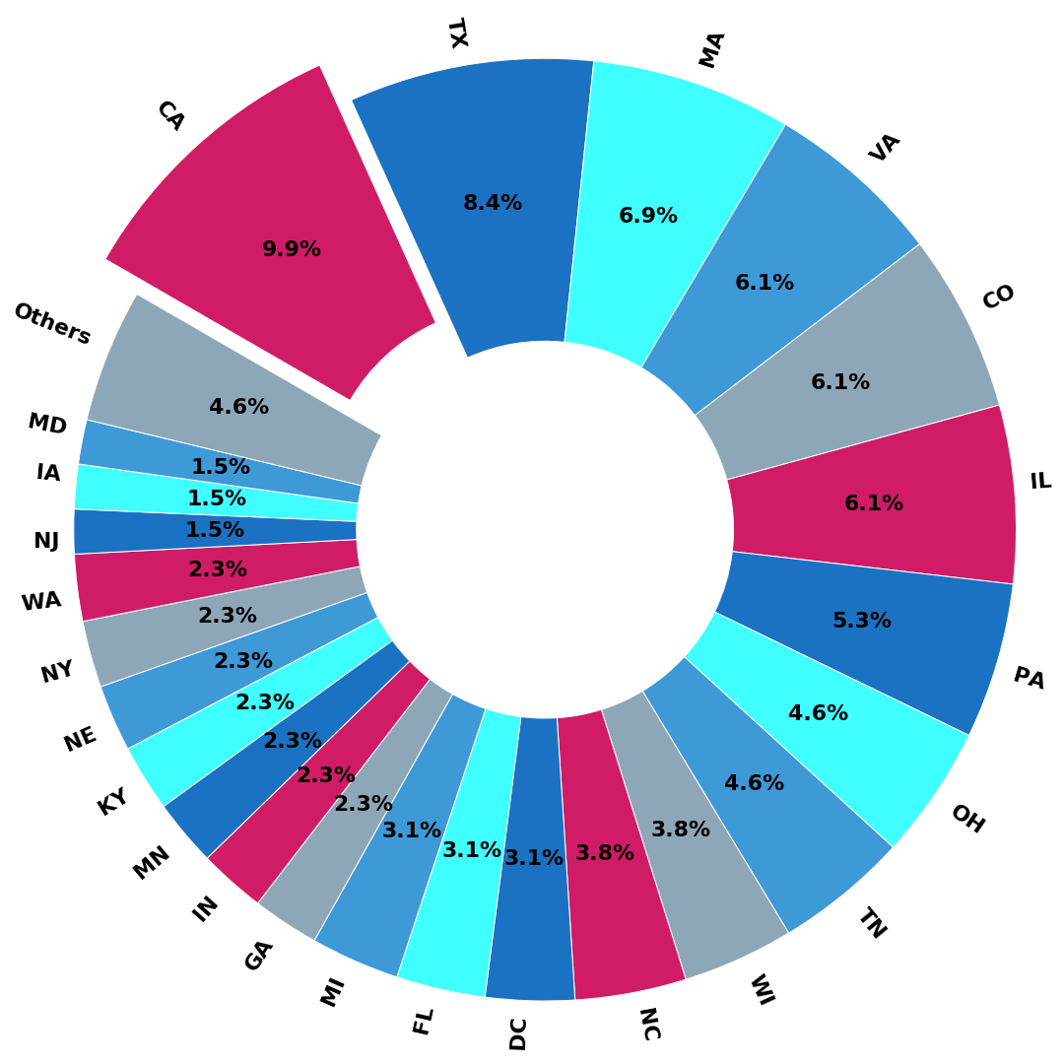
Which State Needs Business Analysts The Most?
California needs Business Analysts the most,taking over 10% Business analyst roles, secondly it’s Texas, with a share of 8.4%. And Massachusetts, Virginia, Colorado and Illinois take over almost the same share, between 6% and 7%, in the Business analyst job market.

Slide 22
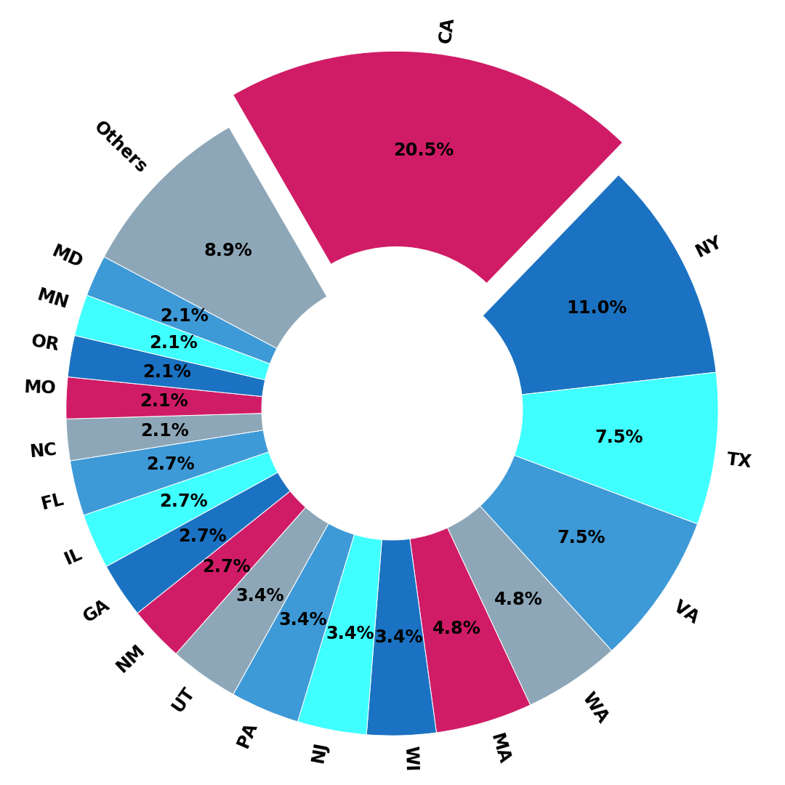
Which State Needs Data Analysts The Most?
California needs data analysts and data scientists the most, taking over about 20% market share, which makes sense because Silicon Valley is a core of technology industry.

Slide 23
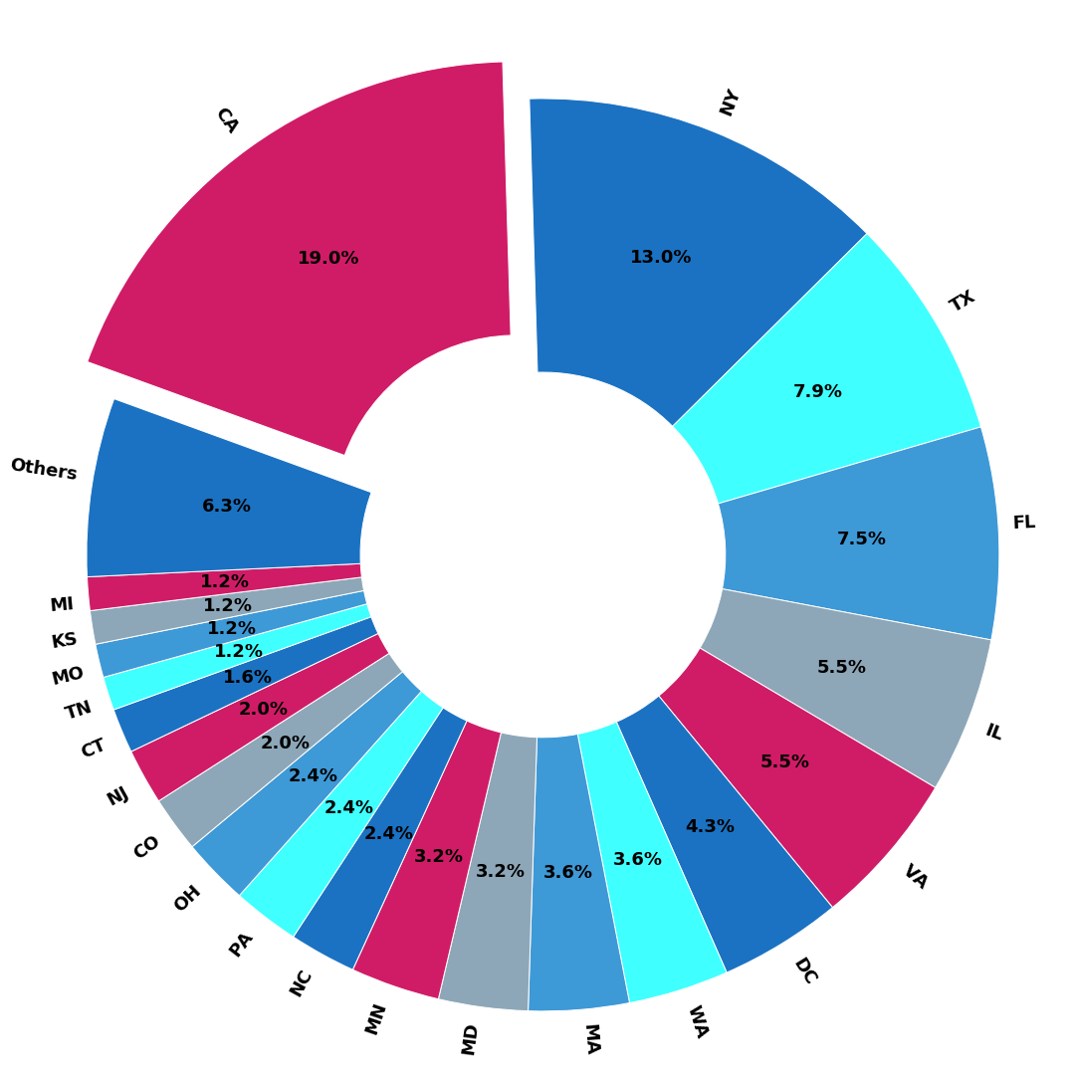
How Does Analyst Roles in Other Domains Distribute?
This chart shows the location distribution of analyst roles in health, human resource, legal and other domains. California, apparently, has the largest share, 19%.

Slide 24

Description-wise Analysis

Slide 25
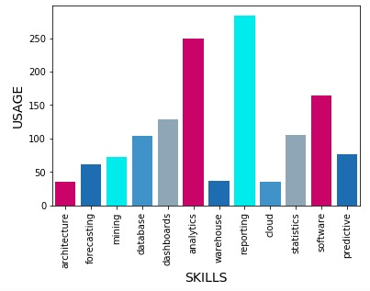
Skills (Using Keyword Filter)

Slide 26
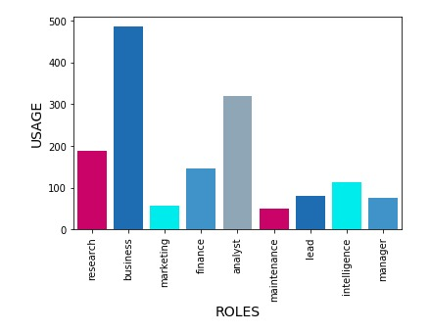
Roles (Using Keyword Filter)

Slide 27
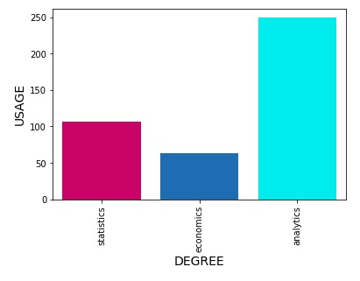
Degree (Using Keyword Filter)

Slide 28
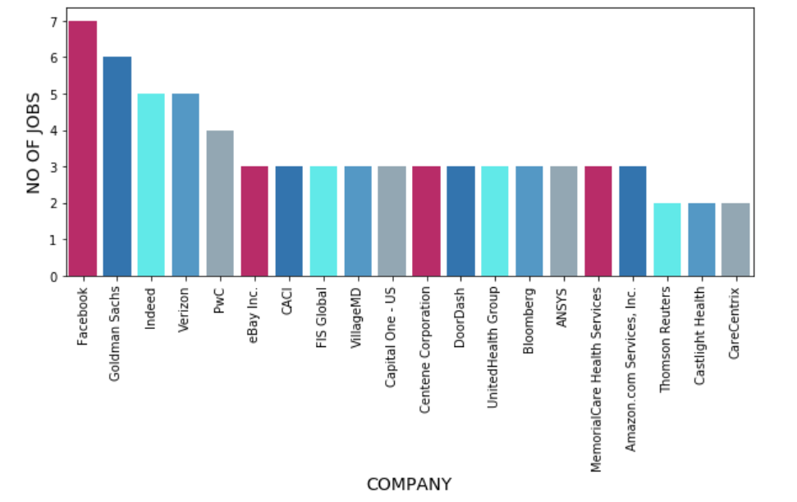
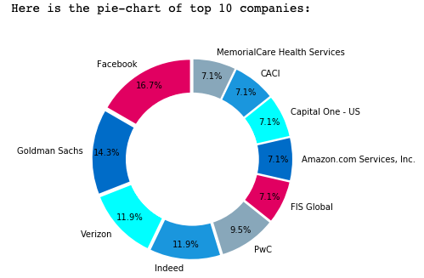
Number of Jobs - (Company Wise)

Slide 29

Add-on: Big-4 Accounting Firms Analyst
In this part, we will be analysing 4 datasets scraped from Indeed based on the Big 4 accounting companies: Deloitte Touche Tohmatsu Limited (Deloitte), Ernst & Young (EY), KPMG International Cooperative (KPMG), and PricewaterhouseCoopers (PwC).

Slide 30
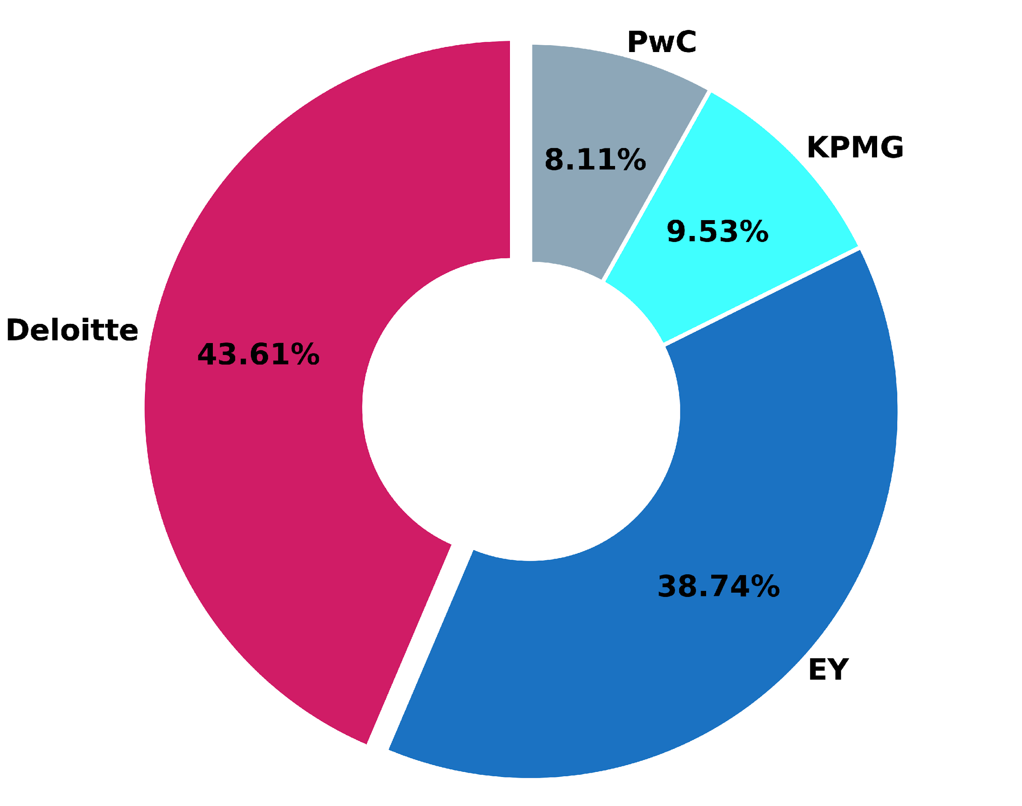

Company Share
Deloitte has the largest share among the Big-4 Account Firms, taking over 40% of the job market of analysts.

Slide 31
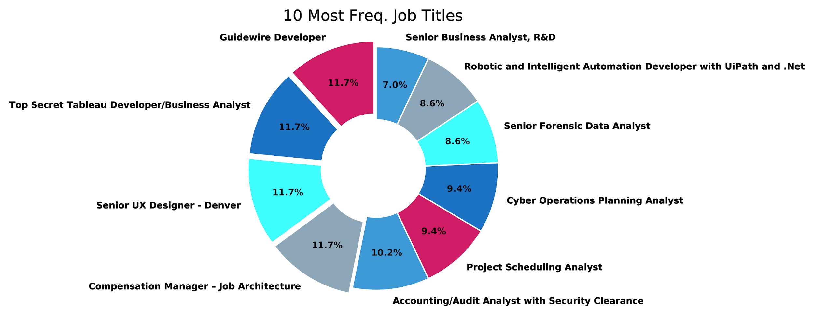
Most Listed Job Titles
Guidewire Developer, Tableau Developer/Business Analyst, Senior UX Designer, and Compensation Manager are the 4 most hot-handed job in the Big-4 accounting market.

Slide 32
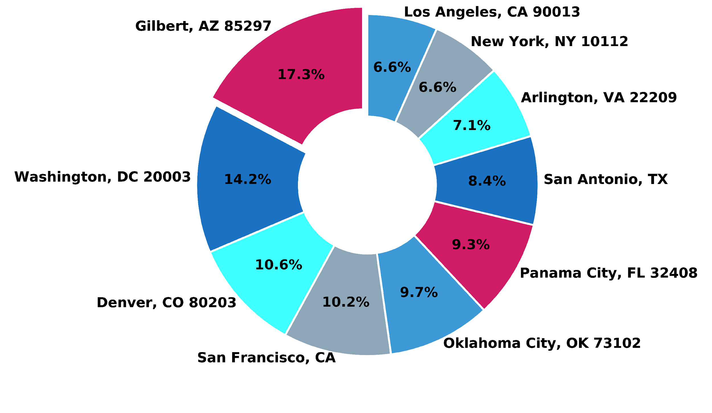
Most Frequent Locations
Gilbert, AZ has the most job opportunities, followed by Washington, DC. There are only 2 cities in CA in the top-10 tire, which is San Francisco, ranking at the 4th, and Los Angeles, raking at the 10th.

Slide 33
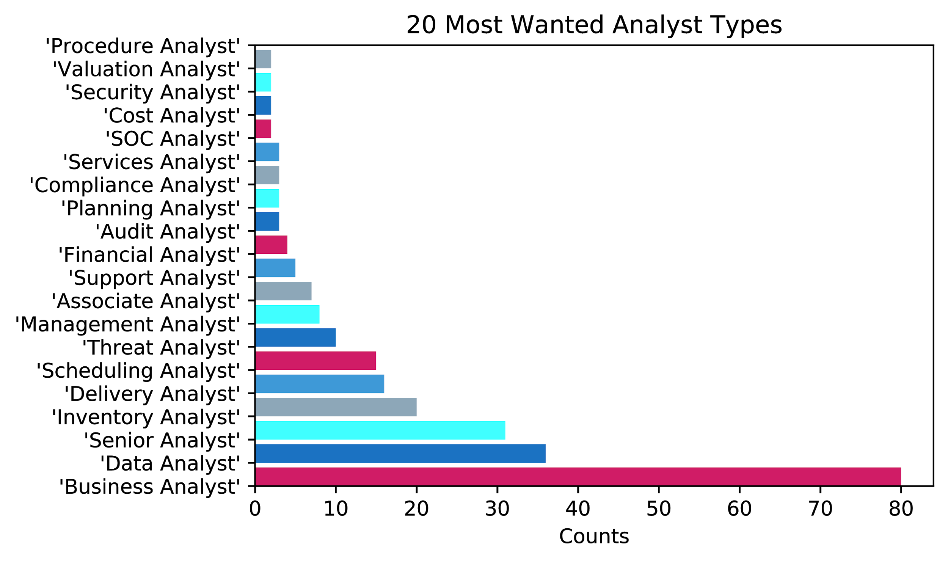
Most Wanted Analyst Jobs
Using the Re method, the word pairs of ‘XXX Analyst’ were filtered out. The below chart shows that the highest 3 occurrence jobs were Business Analyst, Data Analyst, and Senior Analyst.

Slide 34
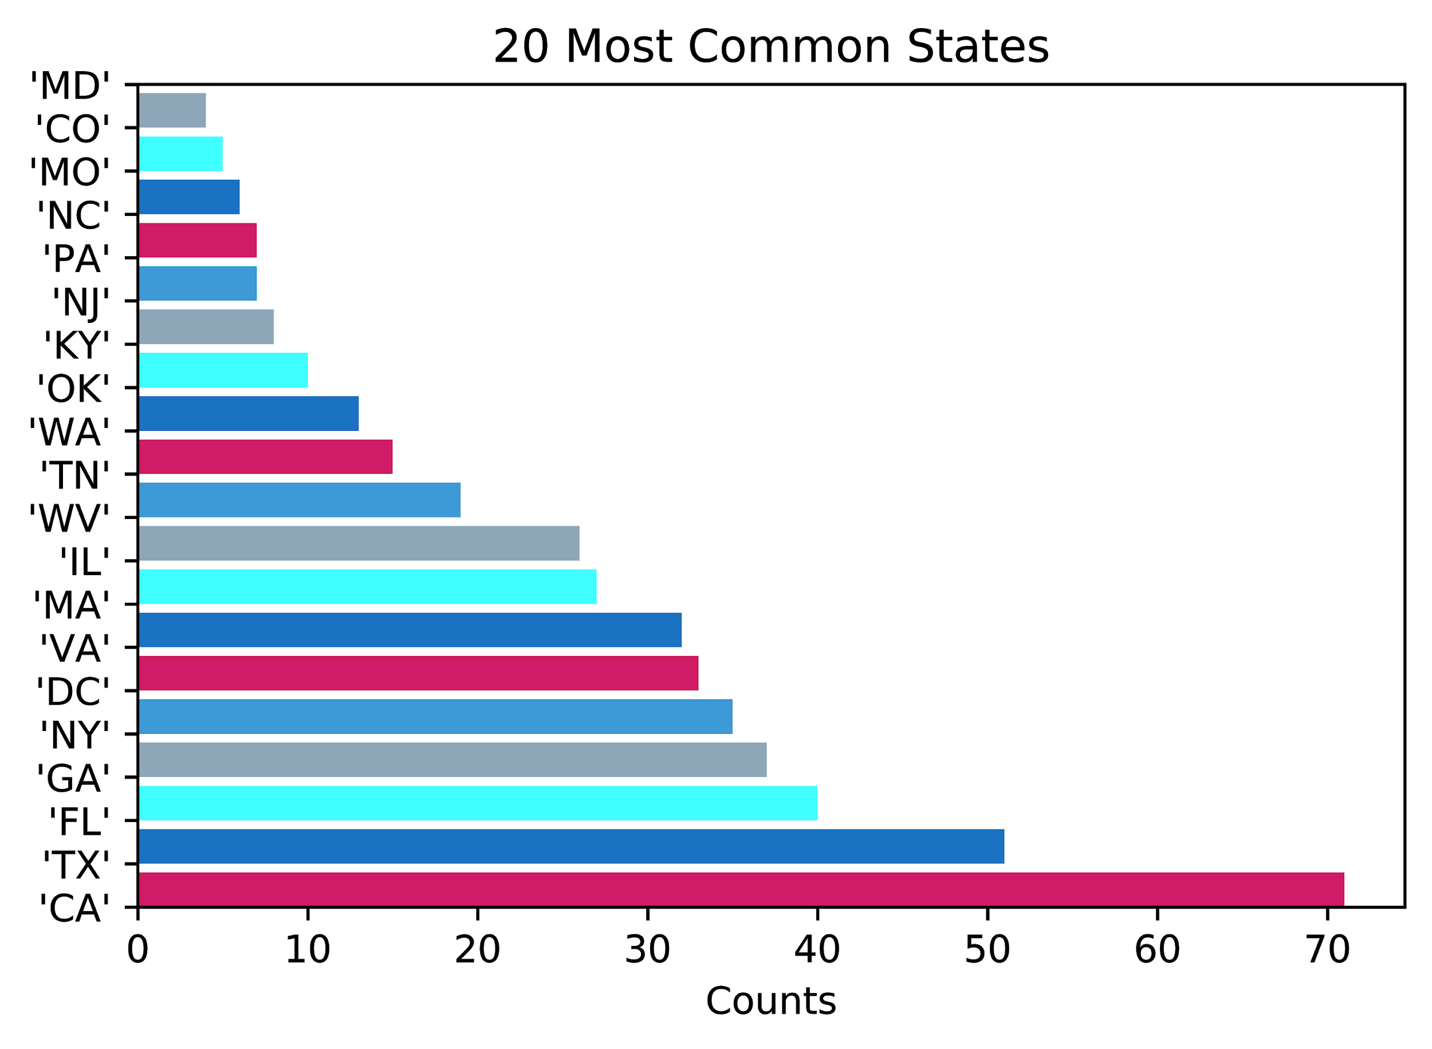
Most Common States
Using the Re method, the states were filtered out. The below chart shows that the highest 3 occurrence states are California, Texas, and Florida.

Slide 35
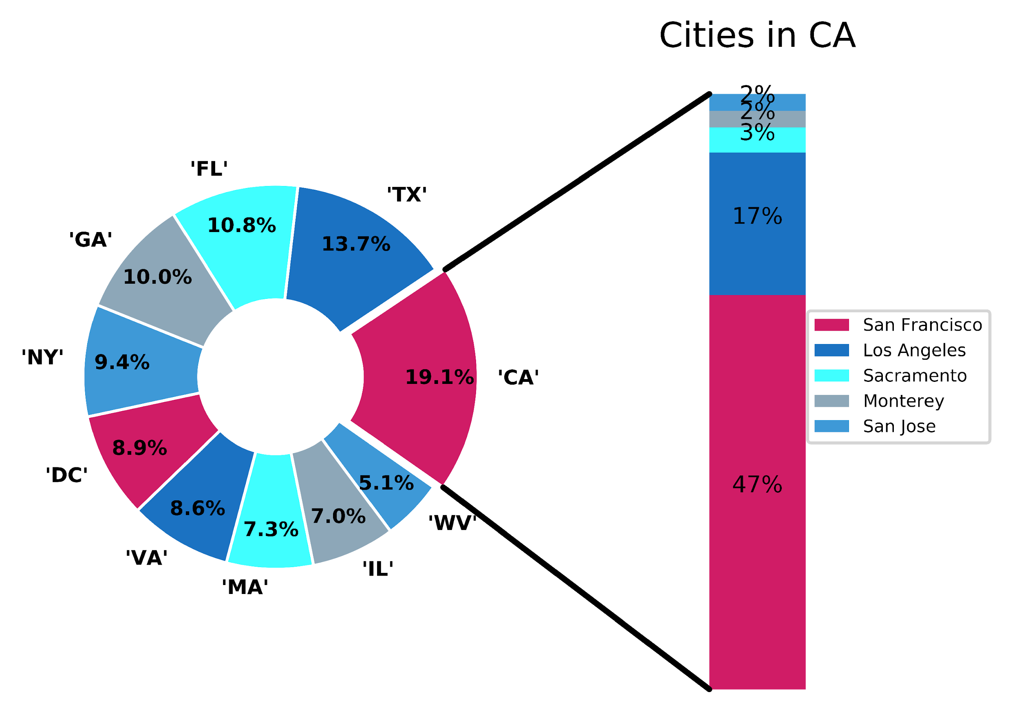
Most Common Cities in CA
Using the Re method, the cities were filtered out. The below chart shows that the highest 3 occurrence cities in California are San Francisco, Los Angeles, and Sacramento.

Slide 36
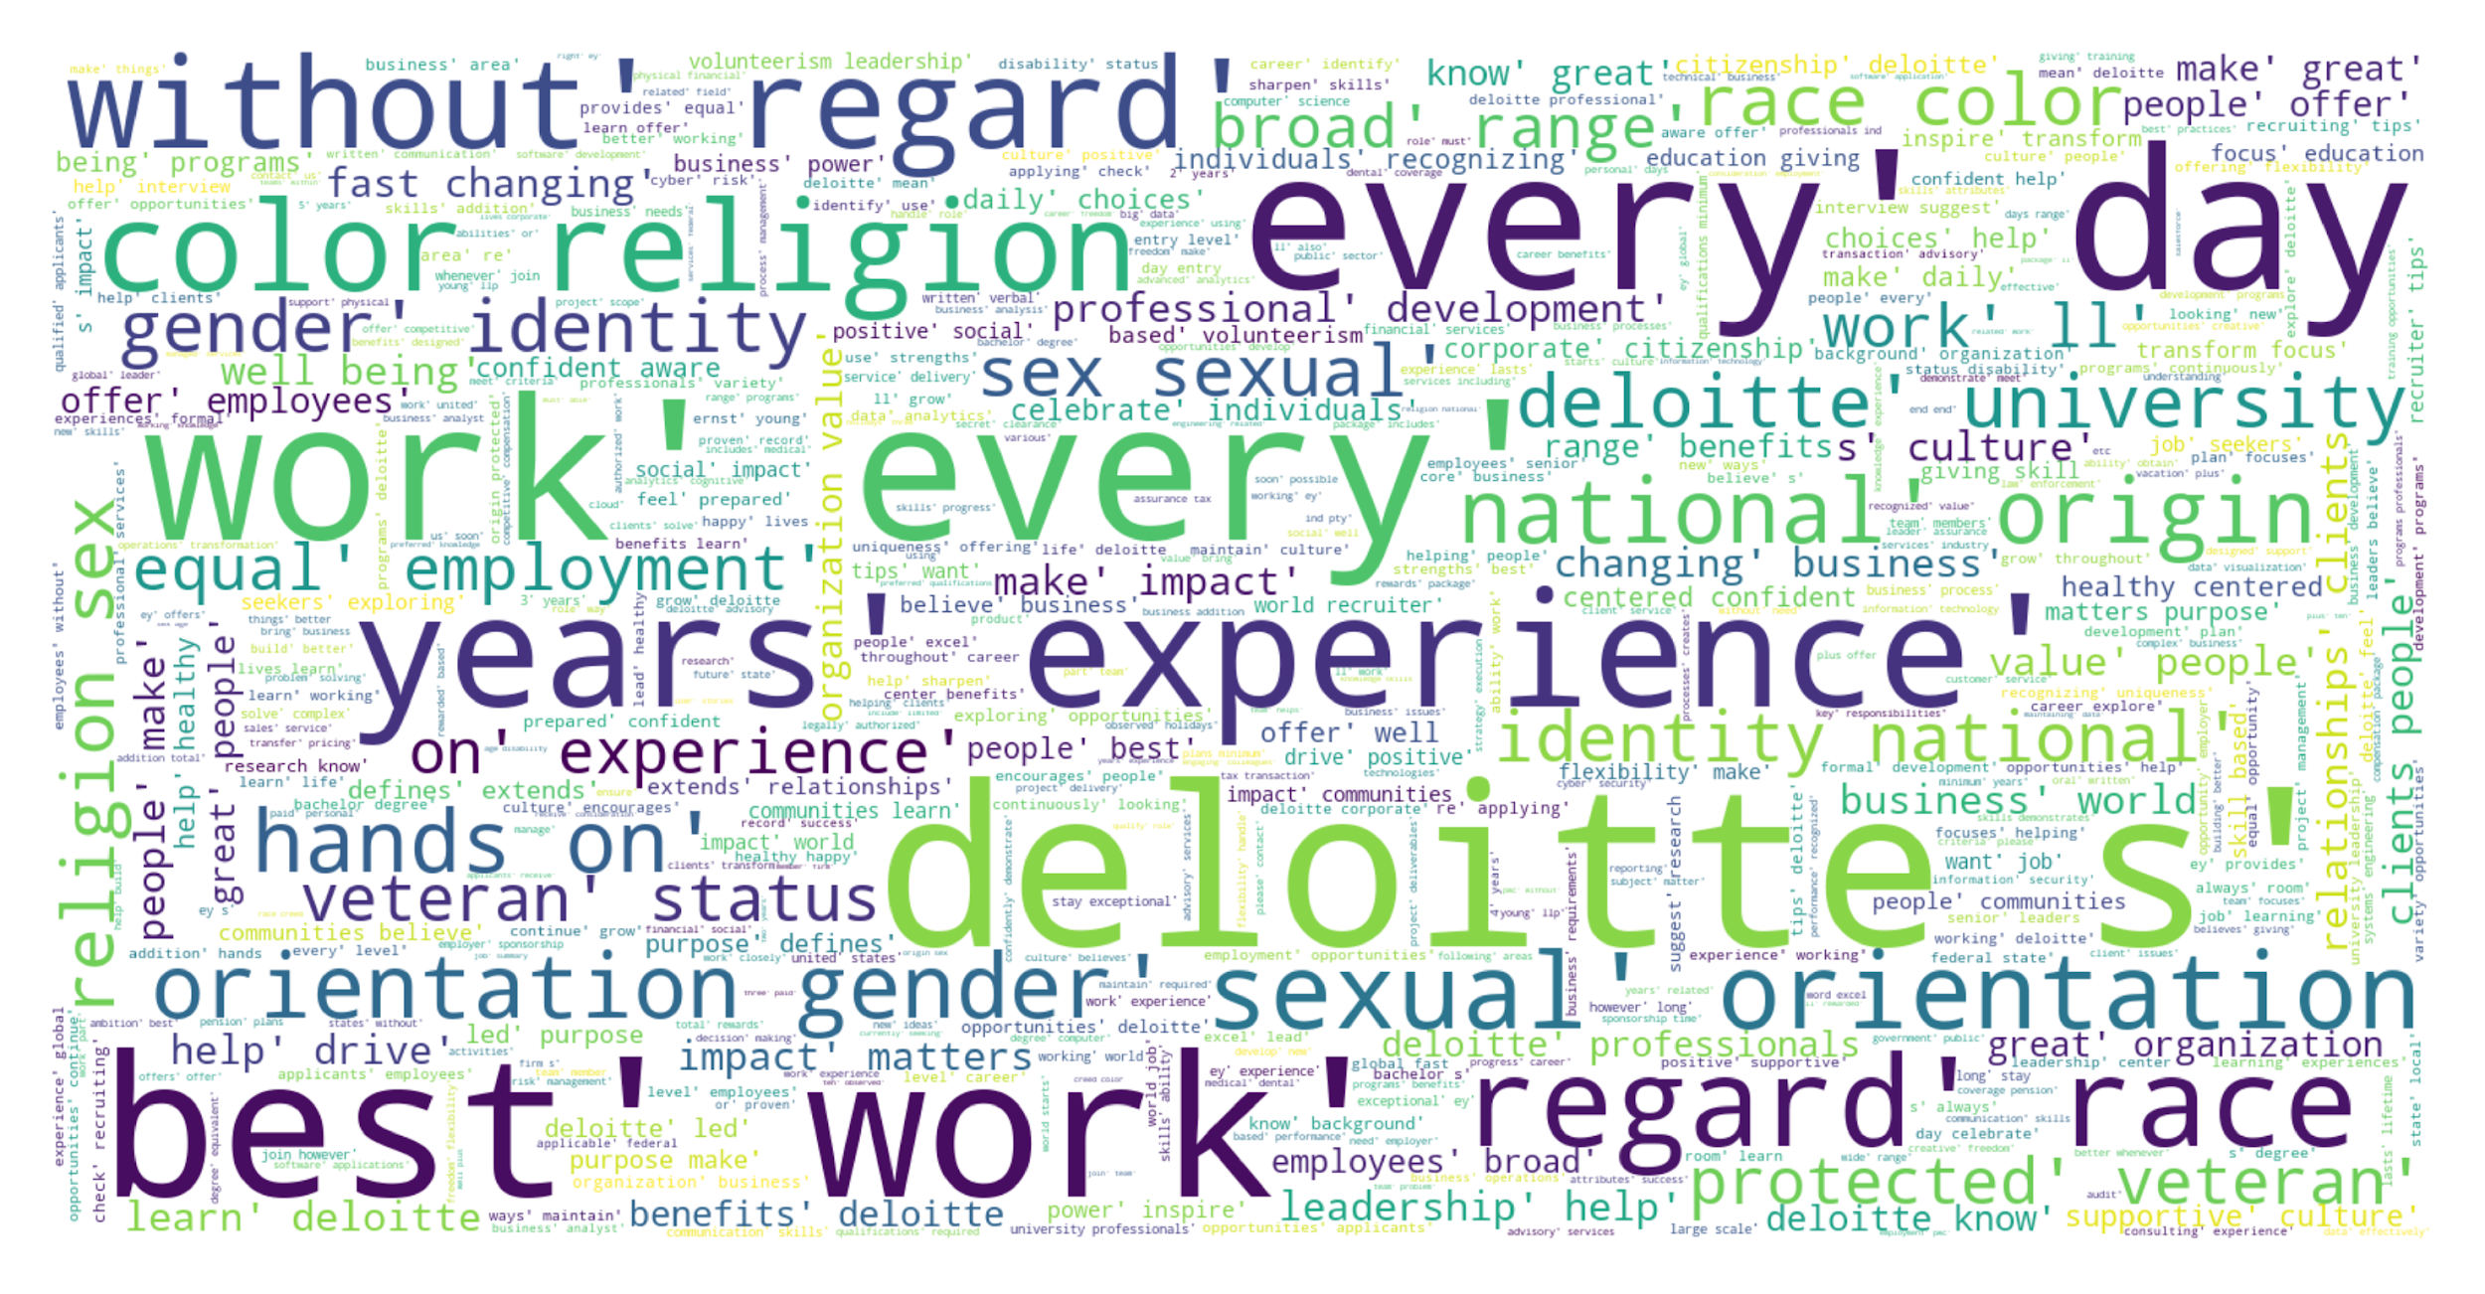
Job Descriptions Word Cloud
Using the Natural Language package in Python, the relatively higher occurrence words in all job descriptions include ‘deloitte’, ‘years’, ‘experiences’, ‘religion’, and ‘work’.

Slide 37
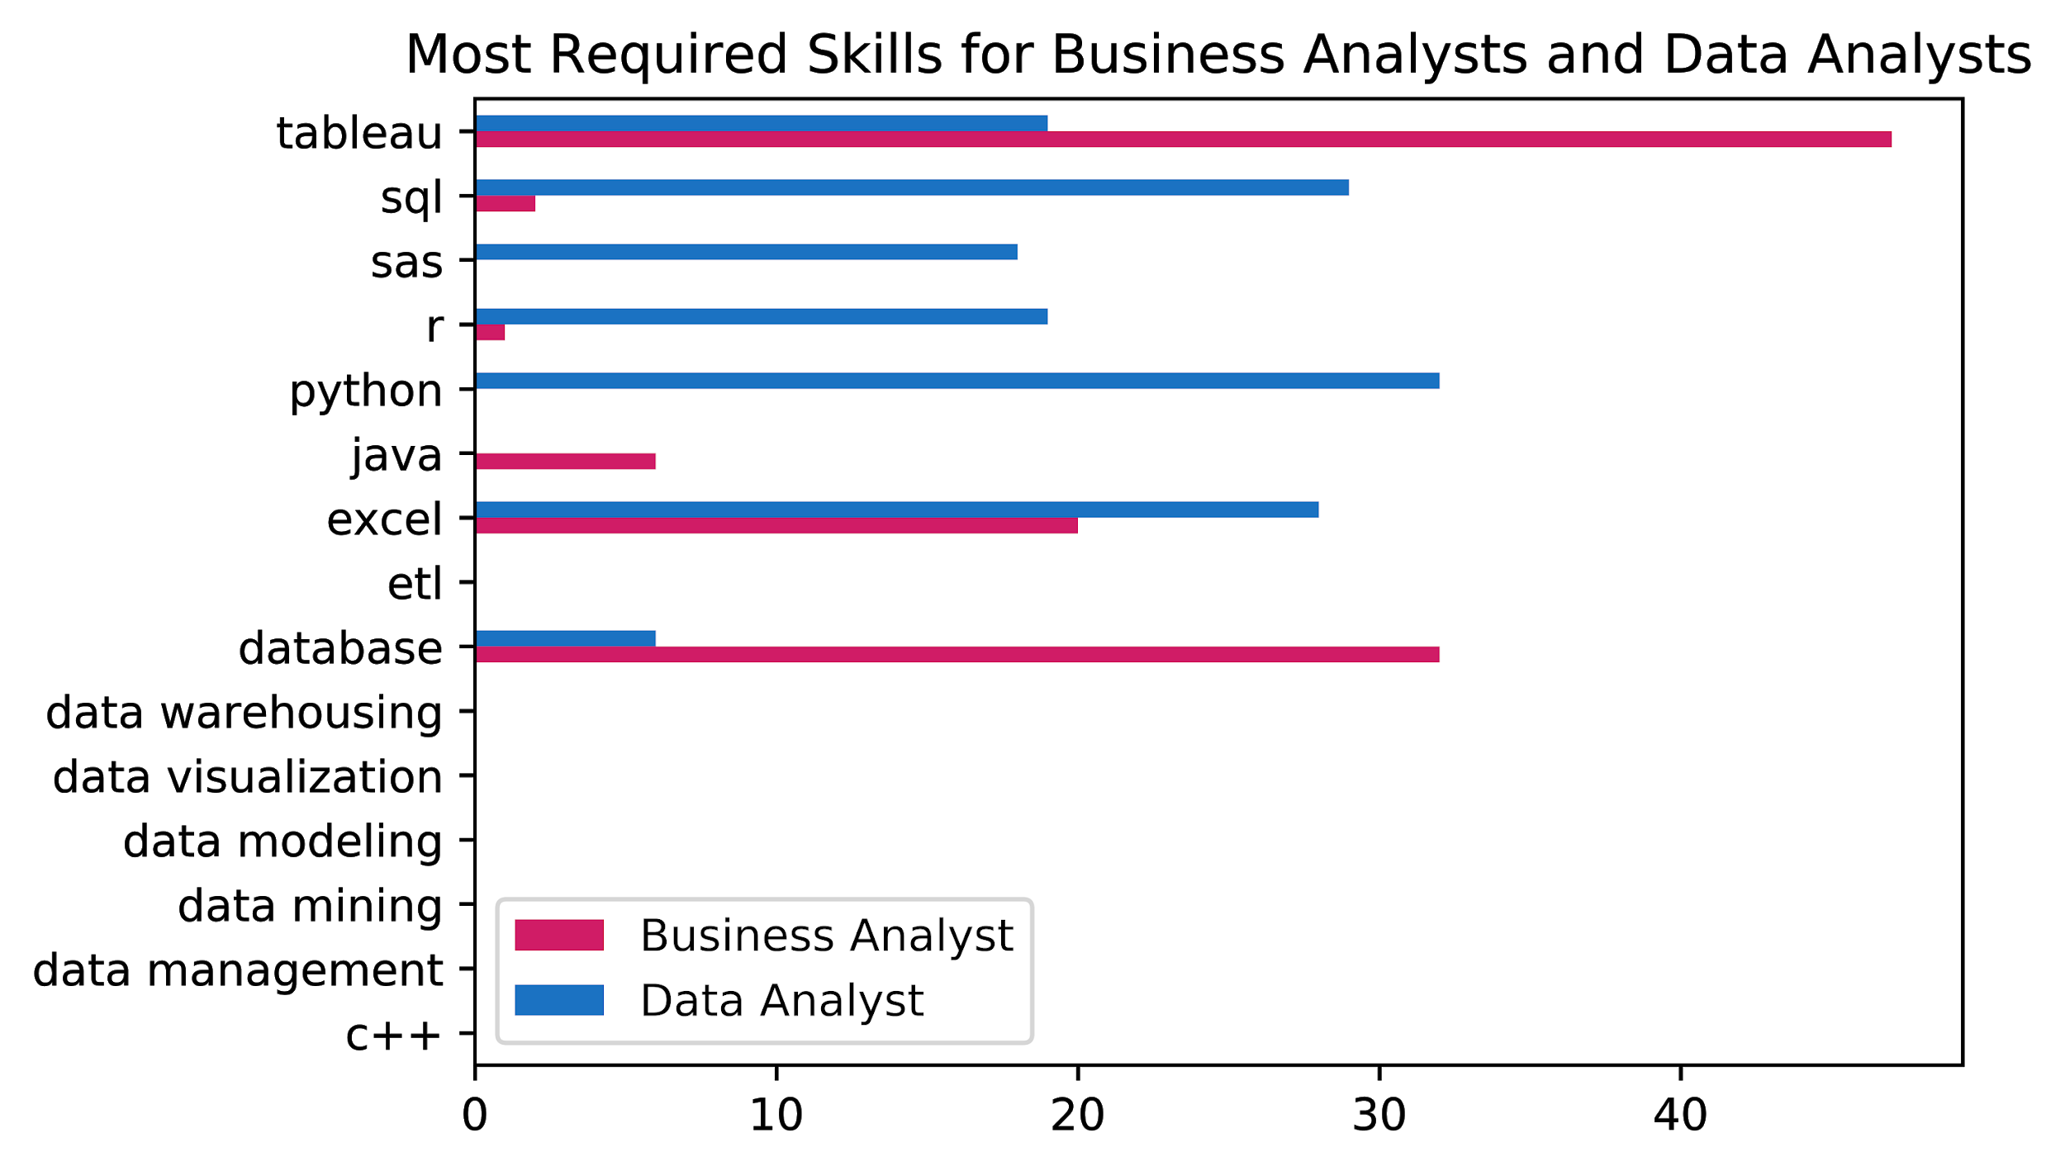
Most Required Skills
Using the Re method, some selected keywords were filtered out. The below chart shows the most required skills for the 2 most required analyst jobs: Business Analyst and Data Analyst.

Slide 38

THANK YOU!
Any questions?
Please don’t hesitate to ask!

